Slide 1
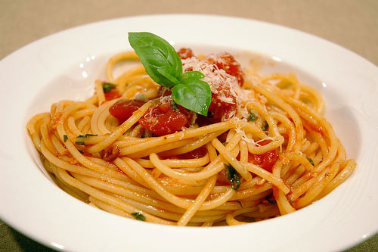

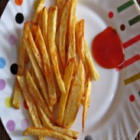
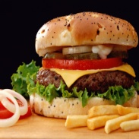
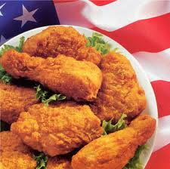
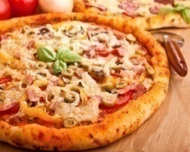

Capstone Project K4C - Group 12
Fast Food Delivery System
December, 2012

Slide 2




Team member
Supervisor:
Kieu Trong Khanh
1
Huynh Thanh Tam (Leader)
Team Members:
2
Pham Viet Phu
3
Nguyen Van Long
4
Huyen Ton Nu Uyen Thu

Slide 3
Outline
Introduce about the scenario system
Disadvantages of scenario system
Introduce about solution
Overview and purposes
Process
Work flow
Functions
Technologies and development environment
Demonstration
Advantages of solution
Future plan
Q&A

Slide 4





Scenario Process
Case 1: Customer create order directly at store
I want to order some fast food.
Here, your.
Notes:
Content Layouts

Slide 5



Scenario Process
Case 2: Customer create order via website
Notes:
Content Layouts

Slide 6


Scenario Process
Case 3: Customer create order via hotline
Of course, ma’am
Help me to order some fast food
Notes:
Content Layouts

Slide 7


Disadvantages

Slide 8
Overview and Purposes
Improve current fast food delivery system.
Make use of mobile device and web application.
Check out information of customer more exactly
Manage orders, stores, delivery men better.
Increase productivity and efficiency.
Decrease transaction cost and transaction time.

Slide 9





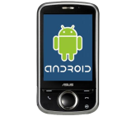
Our Solution

Slide 10
Our Solution

Slide 11



Functions
1
2
3
Create Order
Manage Order
Assign Orders
4
5
6
Assign Store
Automatically

Slide 12



Technologies
1
2
3
Java
Javascript
XML
4
5
6

Slide 13






Development Environment
1
2
3
Windows 7
Netbean
Eclipse
5
4
6
Navicat
MySQL
Apache Tomcat

Slide 14

Design Description
Presentation Layer
Business Login Layer
Data Access Layer
Database

Slide 15
Scenario
Actors
Customers
03 Stores
03 Delivery Man
Demo
Create 4 orders with different cases

Slide 16

Demonstration

Slide 17

Scenario (cont) – Case 1
6.Update Status
Delivering
7.Finish
Done
1.Notify
2.Confirm
4.Notify
5.Confirm
3.
Delivery
Confirmed
Ordered
Store
Confirmed
Assigned
Delivery

Slide 18
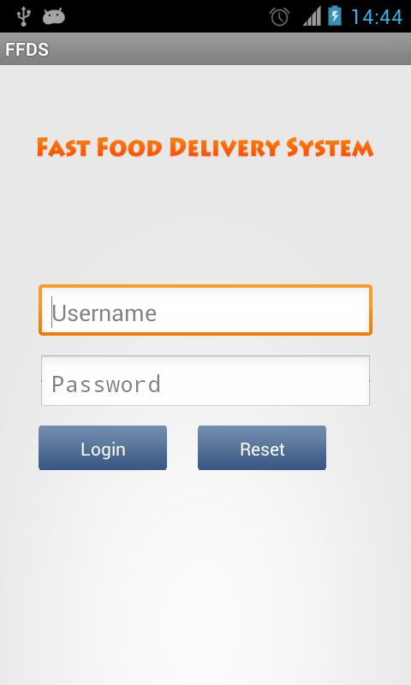
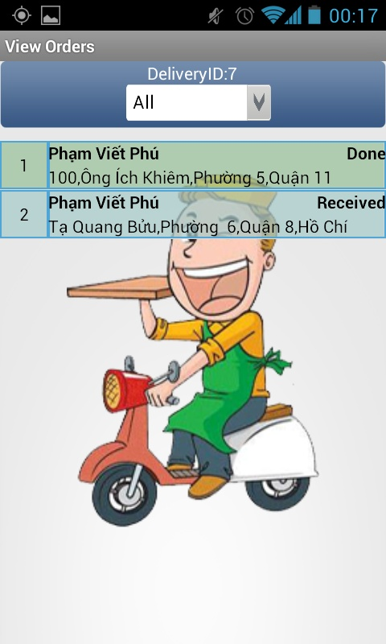
Android Screen

Slide 19
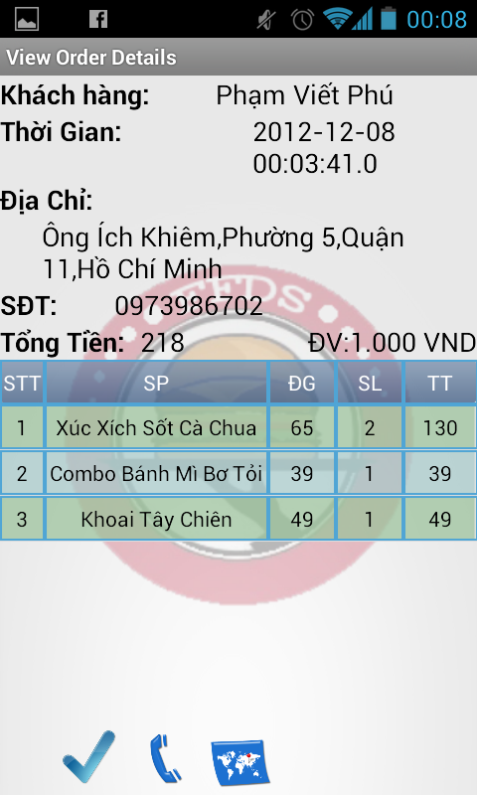
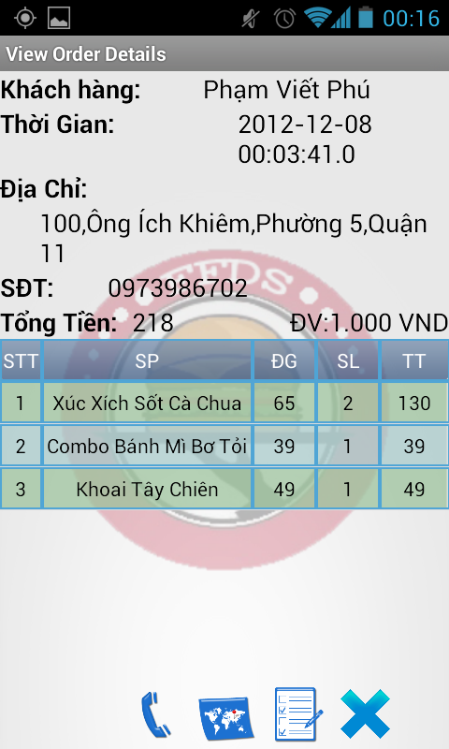
Android Screen (cont)

Slide 20
Scenario (cont) – Case 2
Customer
create order
Customer cancel order among 05 minutes count from time order is created

Slide 21
Scenario (cont) – Case 3
Create Order
Validation
Customer
create order
Store Manager confirm order
Customer call to store to cancel order

Slide 22
Scenario (cont) – Case 4
Receipt create order for customer
Store Manager reject order
Other store confirm order
Assign order
to other store
Delivery Man confirm order and delivery to customer

Slide 23



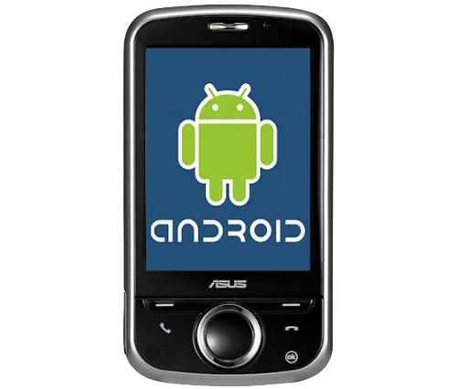
Advantages
1
1
1
1
Make use of
web application
and smart device

Slide 24





Advantages (cont)
Support Statistic
Save Time
Increase Revenue
Support Management
Decrease Business Risk

Slide 25
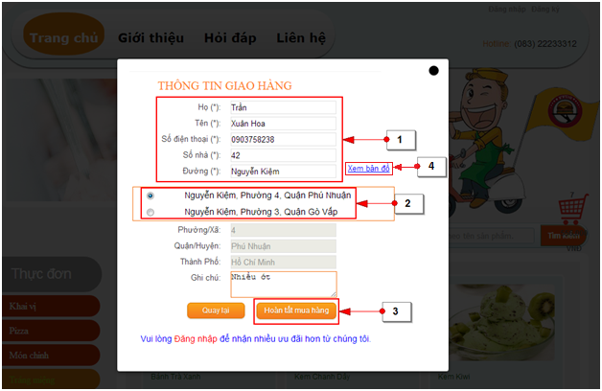
Future Plan
Get address from map

Slide 26
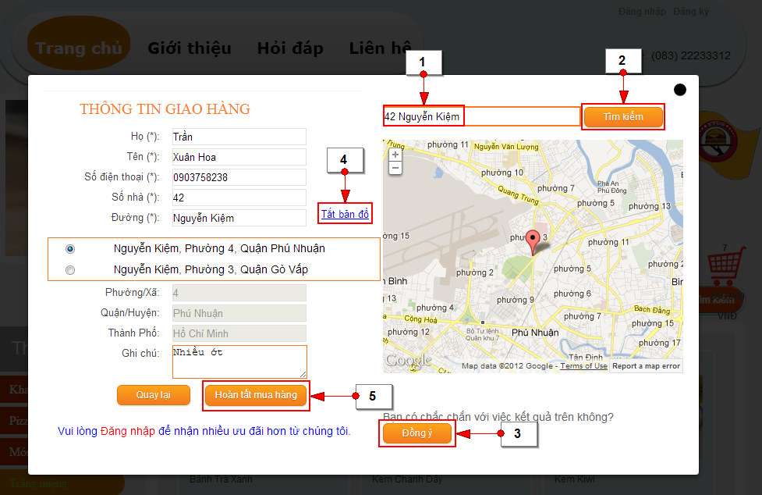
Get address from map

Slide 27
Future Plan (cont)
Keep track on orders
Successful orders
Unsuccessful orders
Assign many order to one delivery man
Expand statistic management
Export report for storage
Develop promotion
Show information about distance and time between delivery man and store, store and customer

Slide 28
Thank For Listening!
December, 2012

Slide 29
Q & A
December, 2012

